Slide 1
19CSE305- MACHINE LEARNING
3 0 3 4 Course Overview

Slide 2
Welcome To The Course
Course code: 19CSE305
Pre-Requisite(s): 19MAT112 Linear Algebra, 19MAT205 Probability and Random Processes
Title: Machine Learning
Semester: 5
Batch: B.Tech CSE(2019-2023 batch)
Slots:
Tuesday : Slot 3[11.00 -11.50]
Thursday: Slot 3[11.00 -11.50]
Friday : Slot 1[8.50-940]

Slide 3
ML Team
Dr. Sikha O K (CSE A, CSE B)
Dr. Manu Madhavan (CSE C, CSE D)
Dr. C.Selvi( CSE E)
Dr. M. Anbazhagan (CSE F)

Slide 4
Course Delivery
Online classes (MS Teams)---- Theory
Live lectures 20 to 30 minutes
Discussion
Lab (MS Teams+ Google Colab) --- 2hrs Per Week
Assignments ( Problems and programming)
Project(Group)
Course Repository – AMPLE/AUMS

Slide 5
Syllabus
Unit 1
Foundations of supervised learning - Decision trees and inductive bias, Regression Vs Classification, Supervised: Linear Regression, Logistic Regression, Generalization, Training, Validation and Testing, Problem of Overfitting, Bias vs Variance, Performance metrics, Decision Tree, Random Forest, Perceptron, Beyond binary classification
Unit 2
Advanced supervised learning - Naive Bayes, Bayesian Belief Network, K-Nearest Neighbour, Support vector machines, Markov model, Hidden Markov Model, Parameter Estimation: MLE and Bayesian Estimate, Expectation Maximization, Neural Networks
Unit 3
Unsupervised Learning: Curse of Dimensionality, Dimensionality Reduction Techniques, Principal component analysis, Linear Discriminant Analysis Clustering: K-means, Hierarchical, Spectral, subspace clustering, association rule mining. Case Study: Recommendation systems
19CSE305 MACHINE LEARNING L-T-P-C: 3-0-3-4
https://kirkpatrickprice.com/blog/classifying-data/

Slide 6
Course Outcome
COs | Course Outcome | Bloom’s Taxonomy Level
CO 1 | Understand issues and challenges of machine learning: data, model selection, model complexity . | L3
CO 2 | Design and implement various machine learning algorithms in a range of real-world applications. | L4
CO 3 | Understand strengths and weaknesses of many popular machine learning approaches. | L4
CO 4 | Analyze the underlying mathematical relationships within and across Machine Learning algorithms. | L3
CO 5 | Apply the paradigms of supervised and un-supervised learning. | L3
https://kirkpatrickprice.com/blog/classifying-data/

Slide 7
CO-PO Mapping
PO | PO1 | PO2 | PO3 | PO4 | PO5 | PO6 | PO7 | PO8 | PO9 | PO10 | PO11 | PO12 | PSO1 | PSO2
CO
CO1 | 3 | 2 | 2 | 3 |  |  |  |  | 1 | 3 |  |  | 3 | 2
CO2 | 3 | 2 | 3 | 2 | 2 | 2 | 2 | 3 | 3 | 3 |  |  | 3 | 2
CO3 | 3 | 2 | 1 | 2 | 3 |  |  |  |  | 2 |  |  | 3 | 2
CO4 | 3 | 1 | 2 | 1 | 3 |  |  | 2 | 2 | 3 |  |  | 3 | 2
CO5 | 3 | 1 | 2 | 1 |  | 2 | 2 | 1 | 1 | 3 |  |  | 3 | 2
https://kirkpatrickprice.com/blog/classifying-data/

Slide 8
Evaluation Pattern
65-35
Component | Assessments |  | Online | Viva | Marks
Internal [65] | Mid Term |  | 10 | 10 [Project eval1] | 20
 | CA(Quiz) [ 5 quiz*3 ] |  | 15 |  | 15
 | CA(Lab) | Lab Eval1 [10] | 30 |  | 30
 |  | Lab Eval2 [10]
 |  | Lab Eval3 [10]
External [35] | End semester |  | 15 | 20 [Project eval2] | 35
https://kirkpatrickprice.com/blog/classifying-data/

Slide 9
LAB
LAB SESSIONS | TOPICS | KEYWORDS | OBJECTIVE | REMARKS | CO | Roughly 14-15 labs
LAB1 | Python for Machine Learning | Python, Numpy, Scipy, Pandas, and Matplotlib library | To implement the libraries necessary for ML in python | PRACTICE | CO2
LAB2 | Python for Machine Learning | Python, Numpy, Scipy, Pandas, and Matplotlib library | To implement the libraries necessary for ML in python | PRACTICE | CO2
LAB3 | Data Preprocessing and Data Visualization in Python – Practice |  |  |  | CO2
LAB4 | Eval 1 [August First/Second week] |  |  |  |  | 10 Marks
LAB5 | Regression models – Practice |  |  |  | CO2
LAB6 | PROJECT REVIEW 1 Problem Definition, Dataset selection, Exploratory Data analysis and feature engineering [August Last week/ September first week] |  |  |  |  | 10 Marks
LAB7 | Decision Tree, Random forest, interpreting results – Practice |  |  |  | CO2
LAB8 | KNN, Naive Bayes – Practice |  |  |  | CO2
LAB9 | Eval 2 [September Third/last week] |  |  |  |  | 10 Marks
LAB10 | SVM – Practice |  |  |  | CO2
LAB 11 | Perceptron – Practice |  |  |  |  | 5 Marks
LAB 12 | PCA – Practice |  |  |  | CO2
LAB 13 | Clustering – Practice |  |  |  | CO2
LAB14 | Eval 3 [October Last week] |  |  |  |  | 10 Marks
LAB 15 | PROJECT REVIEW 2 Model selection, implementation and comparison [ November first/second week] |  |  |  |  | 20 Marks
https://kirkpatrickprice.com/blog/classifying-data/

Slide 10
PROJECT
Identified 4 project domains aligned to the subject handling faculty research interest
Dr. C.Selvi- Recommender Systems and IR
Dr. Manu Madhavan- NLP, Bio informatics
Dr. M. Anbazhagan - Recommender Systems and NLP
Dr.Sikha O K- Computer vision and Image processing
https://kirkpatrickprice.com/blog/classifying-data/

Slide 11
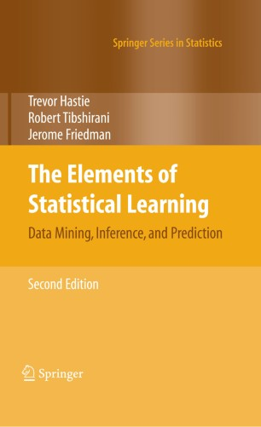
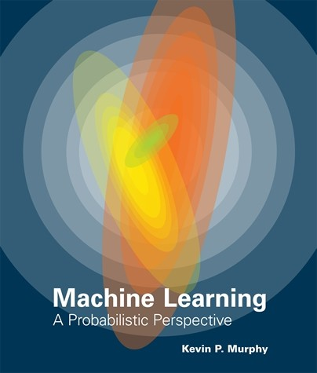
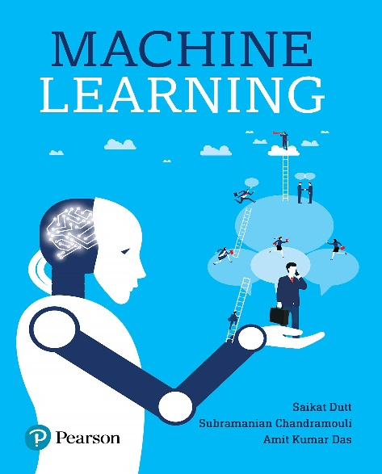
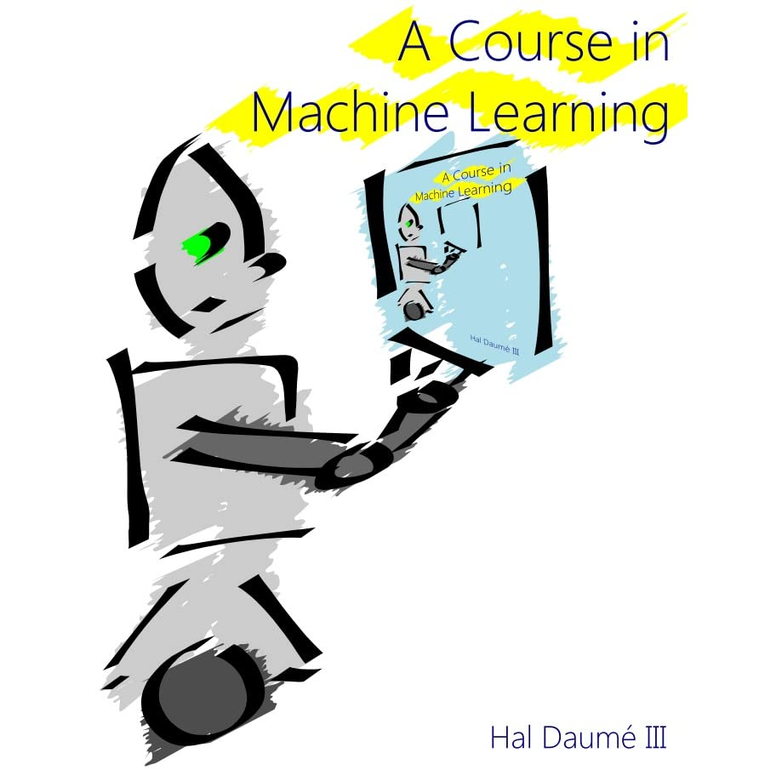
Text Books
Tom Mitchell. Machine Learning. McGraw Hill; 2017
References:
Christopher M Bishop. Pattern Recognition and Machine Learning. Springer 2010
Richard O. Duda, Peter E. Hart, David G. Stork. Pattern Classification. Wiley, Second Edition;2007
Kevin P. Murphey. Machine Learning, a probabilistic perspective. The MIT Press Cambridge, Massachusetts, 2012.
Amit Kumar Das Saikat Dutt, Subramanian Chandramouli -Machine Learning

Slide 12



What To Do Next??
Brush up BASIC PYTHON
Explore Google Colab
Form groups of 4 members (Average CGPA<=7.5)

Slide 13
Happy learning Thank you

